Slide 1

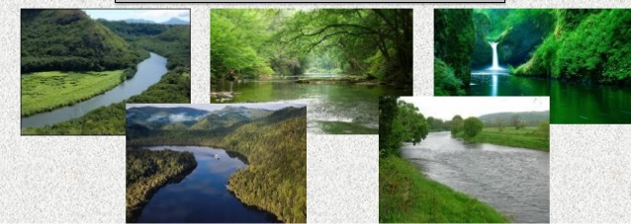
(Management Topic in Environmental Studies)
B. Tech 7TH Semester
Water Resources
Unit 2
Natural Resources
Department: Chemistry
Subject: MTES (CHM2049)

Slide 2
Contents
Water availability
Over utilization and pollution of surface and ground water
Hydrological cycle
Floods
Drought
Sustainable water management
Advantages with reservoirs/dams
Problems with reservoirs/dams
Notes:
2

Slide 3
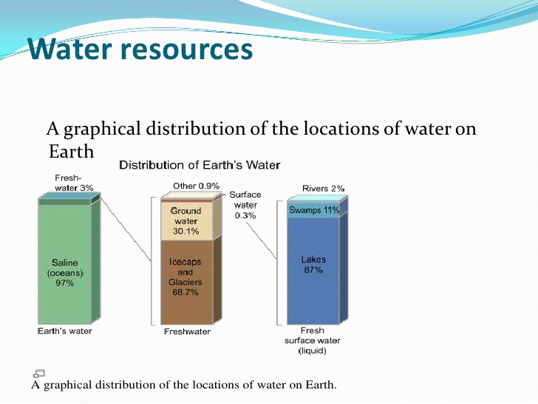
Water availability
70 % land mass in earth under water
Only 3 % fresh water and 97% saline water
Out of this 2 % is entrapped in polar ice cap
1 % water is the flowing water in rivers, lakes and ground water
India is expected to face
critical levels of water stress by 2025

Slide 4
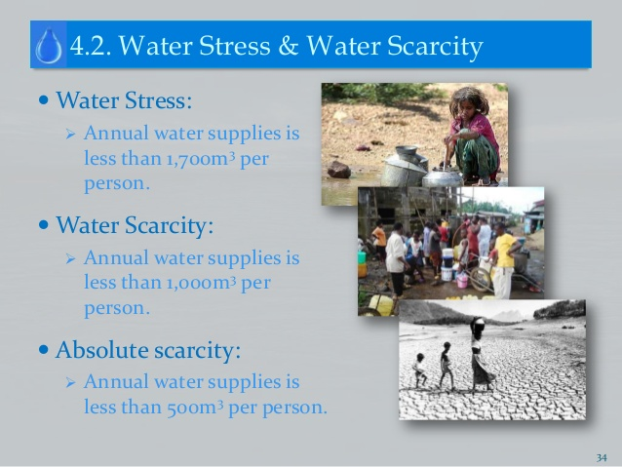
Water Stress & water Scarcity

Slide 5
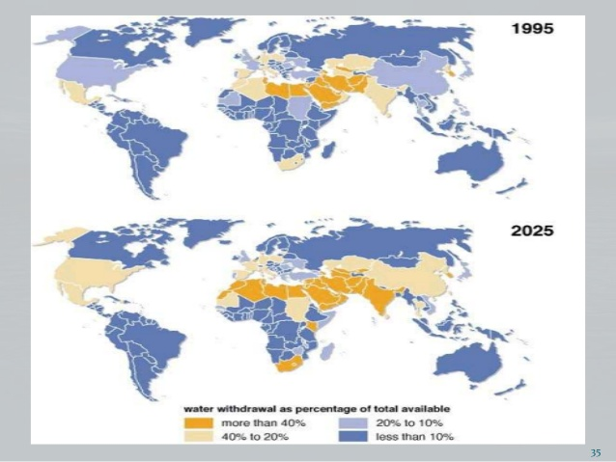

Slide 6
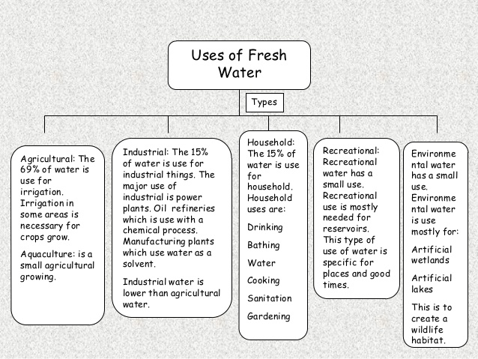
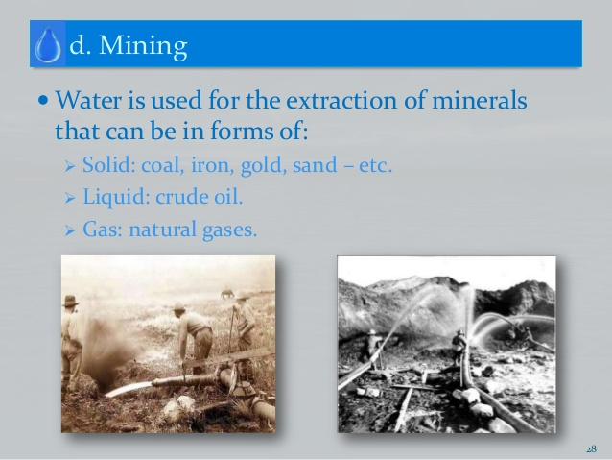
Water use in India

Slide 7
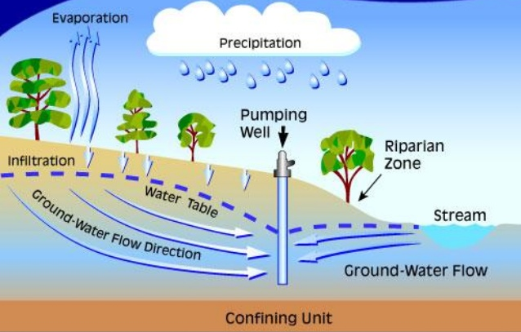
Hydrological cycles-components
Evaporation: The transformation of water in to water
vapour at all surface at all temperature
Transpiration: Evaporation of water from vegetative surfaces like plant foliage
Infiltration: The movement of water into the interior of soil to the ground water regime.
Precipitation: Water vapour forms cloud and results in precipitation in the form of rain fall and snow fall.
Run off: The portion of precipitation percolates ground as ground water and the major portion leaves in different stream as run off.
Precipitation = Evaporation+ Transpiration + Infiltration+ Run off

Slide 8
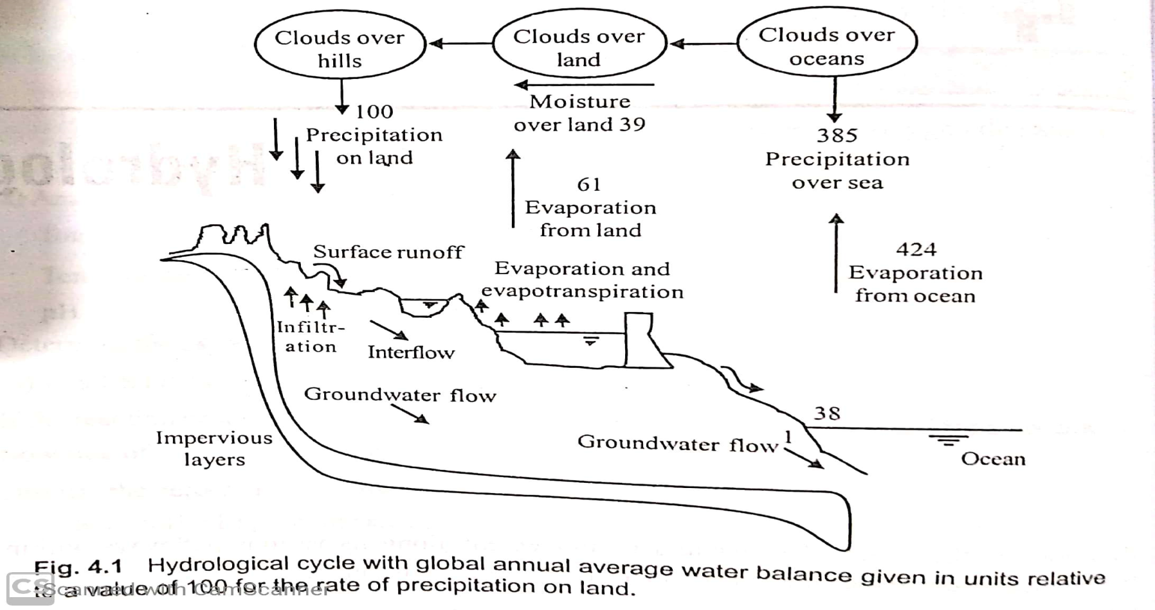
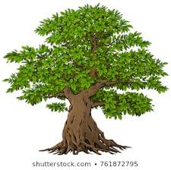


Hydrological cycle
Evaporation
Evaporation
Precipitation
Precipitation
G
Transpiration
Glacier / Snow
Glacier melting

Slide 9
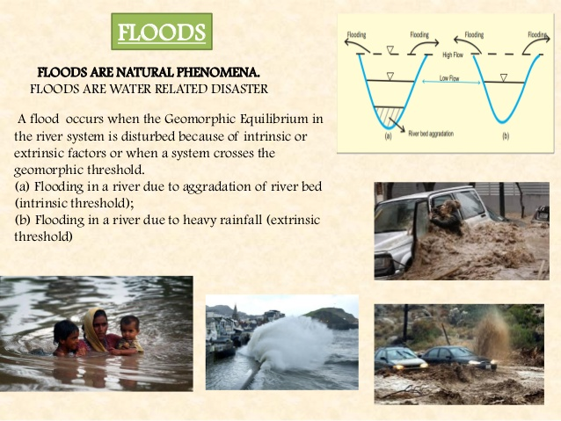

Slide 10
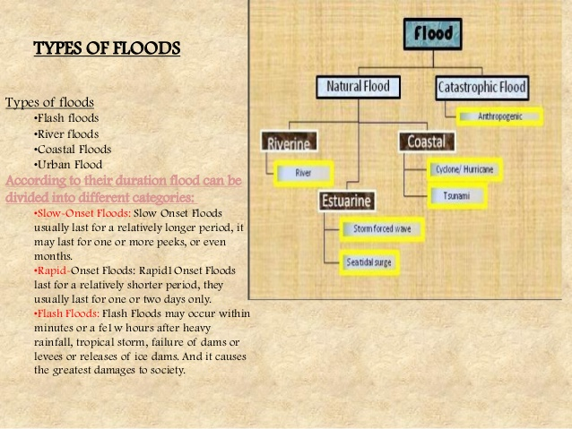

Slide 11
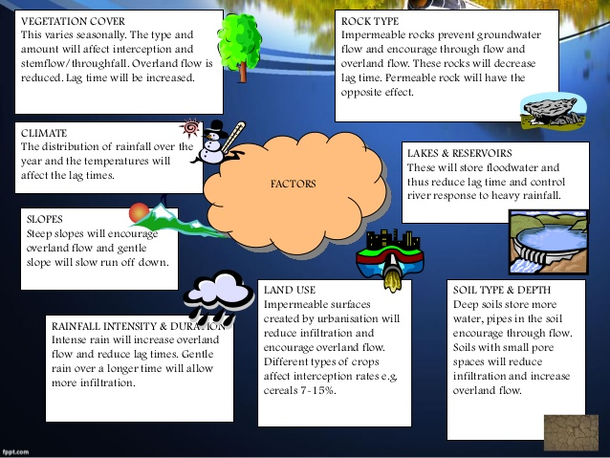
Factor affecting Flood

Slide 12
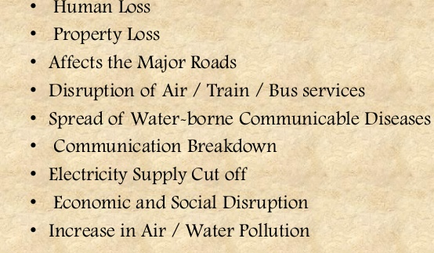
Impact of Floods

Slide 13
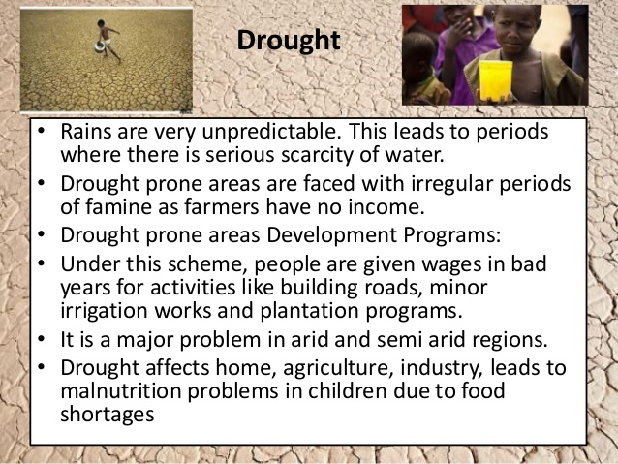
Drought
It is an unpredictable climatic condition and occurs due to the failure of one or more monsoons.

Slide 14
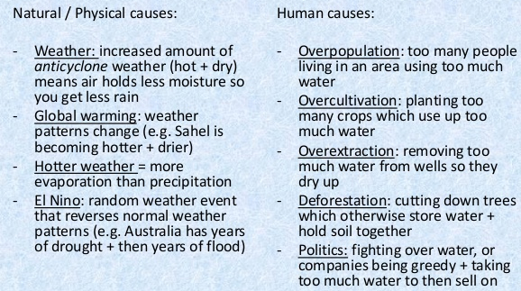
Causes of Drought

Slide 15
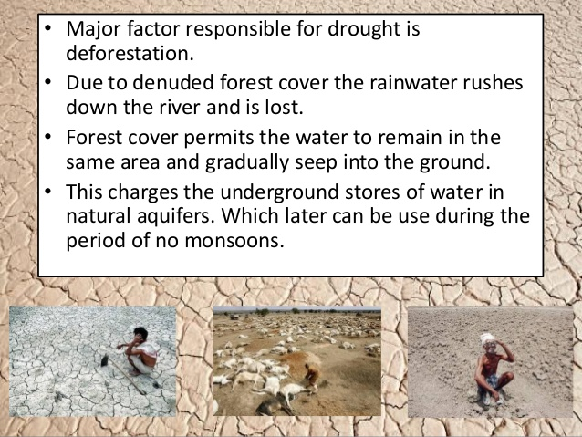
Causes of Drought
Soil and water management and afforestation are long-term measures that reduce the impact of droughts

Slide 16
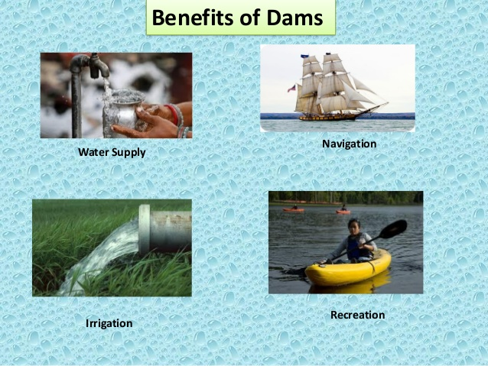
Advantages with reservoirs/dams
India’s increasing demand for water for intensive irrigated agriculture, for generating electricity, and for consumption in urban and industrial centers, has been met by creating large dams.
The major advantages of Dams are
Water supply to intensive irrigated agricultural land
Generation for cheap and non-polluting source of electricity, Hydropower
Water supply to cash crops
Domestic water supply
Water supply to big industries
Fishing activities

Slide 17
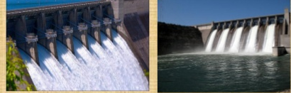
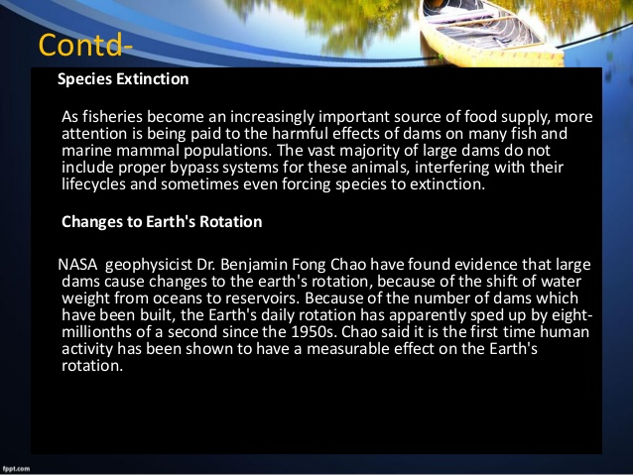
Problems with reservoirs/dams
Submergence of forest land with valuable loss to biodiversity
Sediment deposition in rivers lead to flood and soil erosion
Serious impacts on riverine ecosystems.
Displacement of tribal people.
Water logging and salinity of surrounding lands leading to infertility of the soil.
Dislodging animal populations, damaging their habitat and cutting off their migration routes.
The emission of green house gases from reservoirs due to rotting vegetation

Slide 18
Sustainable water management
Make people aware of the dangers of water scarcity.
Measure for sustainable water management
Building several small reservoirs instead of few mega projects
Develop small catchment dams and protect wetlands
Soil management, micro catchment development and afforestation permits recharging of underground aquifers thus reducing the need for large dams.
Treating and recycling municipal waste water for agricultural use.
Preventing leakages from dams and canals.
Preventing loss in Municipal pipes.
Effective rain water harvesting and ground water recharging.
Water conservation measures in agriculture such as using drip irrigation.
Pricing water at its real value makes people use it more responsibly and efficiently and reduces water wasting.
In deforested areas where land has been degraded, soil management by bunding along the hill slopes and making ‘nala’ plugs, can help retain moisture and make it possible to re-vegetate degraded areas

Slide 19


